Slide 1
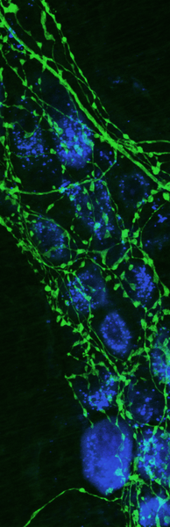

Open source in Science
How contributability, transparency, and other open source practices can revolutionize scientific research
@lisancao
LISA N. CAO
SIMON FRASER UNIVERSITY

Slide 2

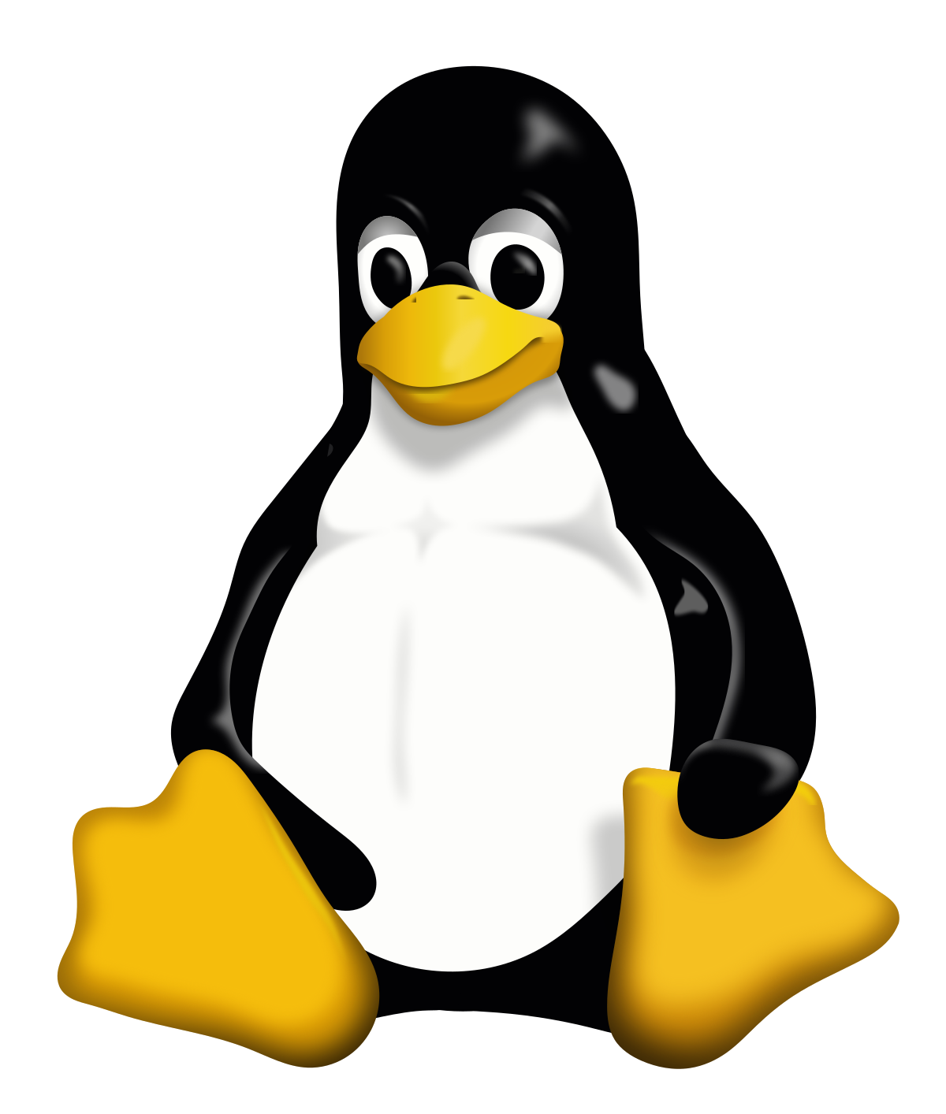
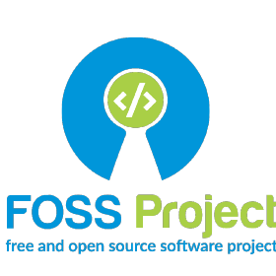
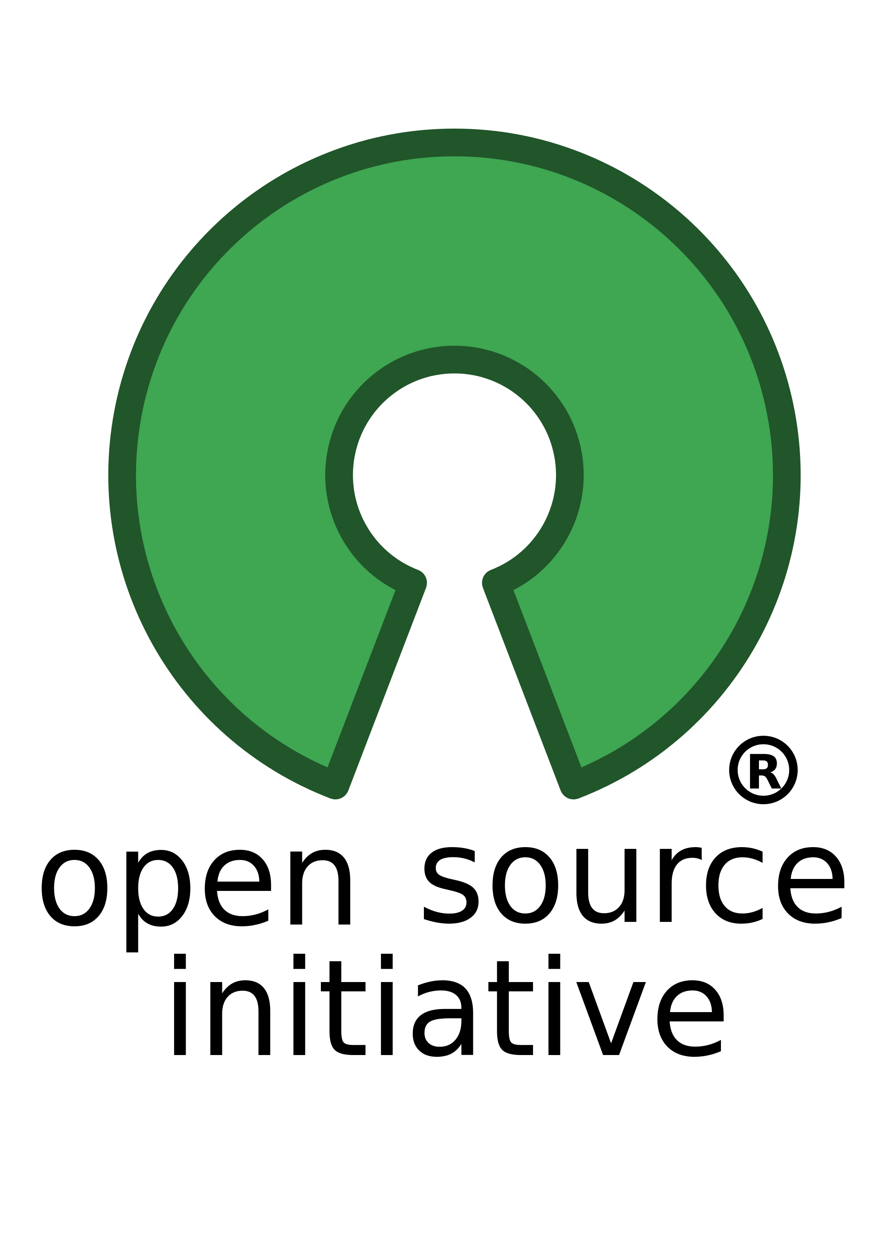


A gentle introduction to Open source
Open Source Software
Publicly available source code
Within the license permissions, be able to be reviewed, reused, and ‘remixed’
Licenses must not require royalties
Can be contributed to by community members of different expertise from all over the world
Has forums where discussion such as new ideas, vulnerabilities, and solutions are discussed
Ideally, comes with good documentation
Can be forked
Free Redistribution
Technology-Neutral
Has options to protect the author’s source code depending on license
Less emphasis on the individual, and more on the community

Slide 3

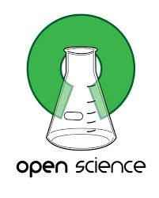


A gentle introduction to research
… as an industry
Scientific Research
Must be:
Reproducible
Impactful/publication worthy (not really)
Involve experimental design, meet research standards, etc
Statistically analysed
Should be:
Assessible by third parties (peer reviewed) from the bottom up (open data)
Accessible to the public, or at least other researchers (open access)
Driven by innovation, sound scientific practice, technological advancements, and collaboration
RE-PRO-DU-CI-BLE!!!

Slide 4
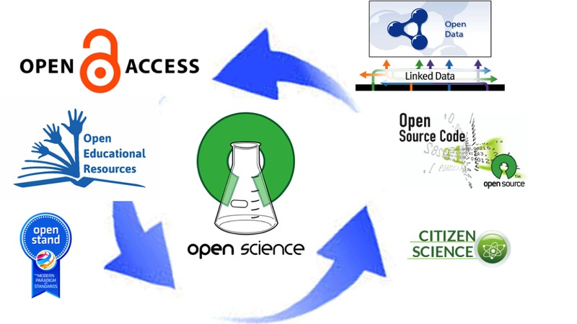
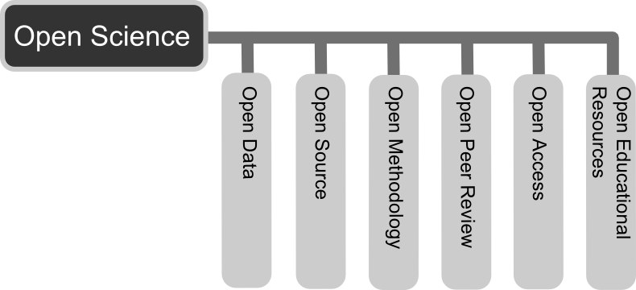
The open science framework
Image Source: Andreas E. Neuhold
Image Source: http://www.sci-gaia.eu/osp-enab/

Slide 5
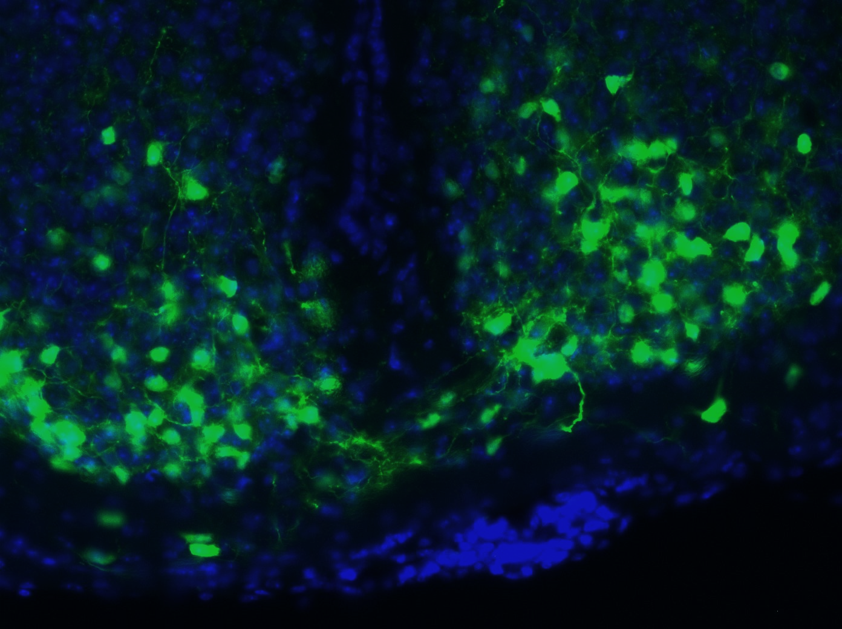
Redundancy in the system:
How scientific software development currently works

Slide 6
Coding when you’re not a software dev
My data has been collected, but I have issues with analysing it due to it’s unique nature
E.g. a special imaging filter for x brain area, or cell sorting based on these principles, or time series analysis
In order to solve this problem, I’m going to write some code in x program
(Performs the analysis)
(Publishes the results in a peer-reviewed paper that doesn’t go through my code line-by-line)
(Leaves the code on local server for either future use or abandons it entirely)
OR: “This is really good I’m going to attempt to license and sell it”

Slide 7
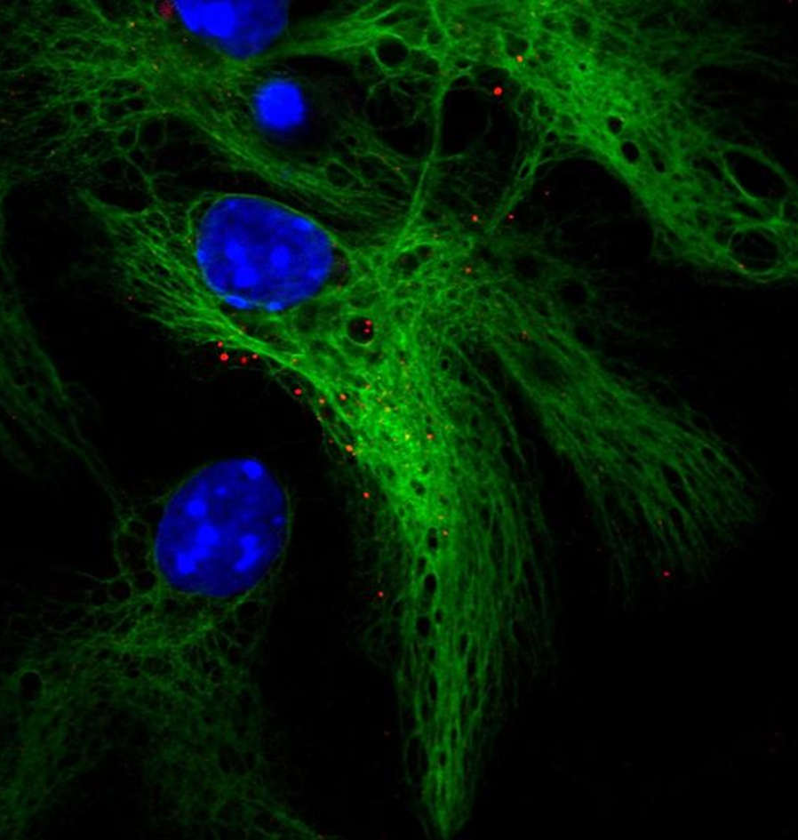
Code redundancy in science
Within niche fields, there are unique software needs that are only understood by researchers in that particular field. Therefore..
You get a lot of code written by informal programmers
Code which may not be the most efficient
You get several labs presenting the similar solutions, each written independently
Some which may do certain things better than others
All of which take time from their respective labs
None of which are collaborating with each other to present the ideal solution
May not even be publicly available for other researchers to use
Due to their status as a researcher in primarily another field
Cannot provide ongoing support and are unwilling to bugfix for others
Abandon development once there is no longer incentive to (aka when the analysis is complete)

Slide 8
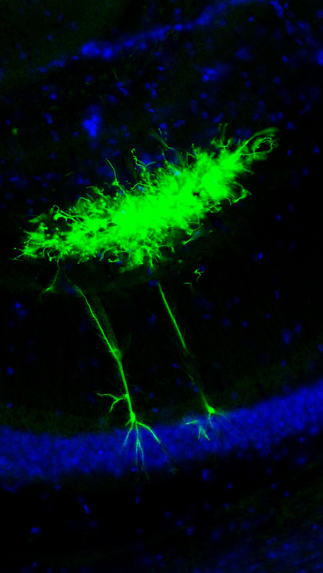
therefore
You get many people writing similar code that does the same thing.
Core issues:
High amounts of redundancy
Variability in quality
Not reproducible
May actually be buggy, especially across different platforms
Has no dedicated development team or community support for maintenance
Not officially released
If it has none of the issues listed above, it is packaged and sold with a nice GUI
This is because most researchers not in computer science fields have no coding background and are thus code-phobic
Get those sweet, sweet citations
Can charge for licensing

Slide 9
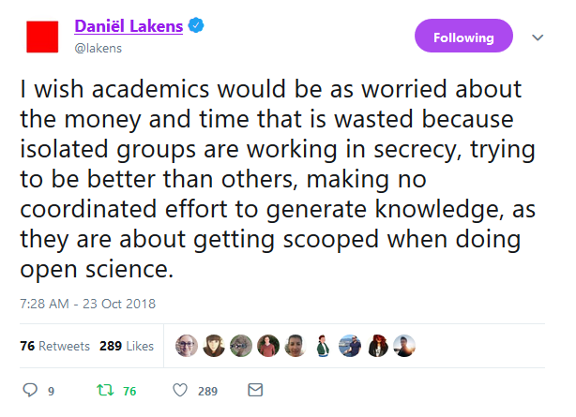
THE ANTISOCIAL STATE OF ACADEMIA: a tweet

Slide 10
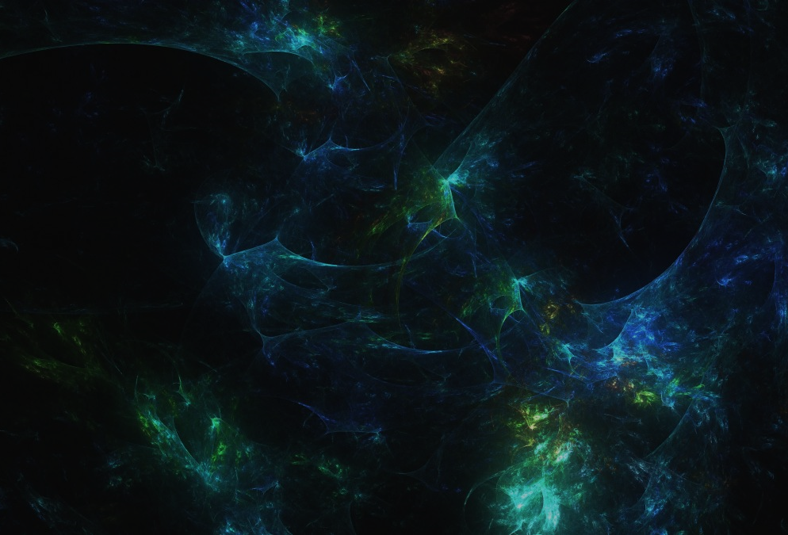
Centralization & stratification
To first de-centralize, we must first centralize

Slide 11
Proprietary software is harmful to scientific progress and reproducibility
Domains of software: Getting stuck in your own bubble
“Well, if we already know how to use x software then we should just try to use it for everything, the university has already paid the licensing fee and we spent all this time learning it”
MATLAB
SPSS/ SAS
PRISM

Slide 12
How can we solve this?
Centralization : continue building onto and prioritize educating researchers in existing programming languages that are free to use
Build a community on a platform that fosters communication
Host on popular sites such as GitHub, GitLab and be as accessible as possible
Improve the source code as much as possible and allow others to do the same, contribute to other projects and their source code
Stratification: allow others to use your code, and actively use other people’s code
Understand what is useful and what isn’t useful for what you are trying to do
Actively try to build comprehensive projects instead of patch-work scripts
Share your specialized version of the code with others
But most importantly: shift our attitudes and begin seeing tech proficiency as part of conducting cutting edge science

Slide 13
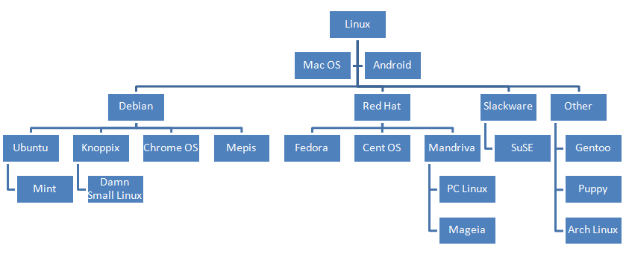
Examples of stratification around a central base code or algorithm
Google’s Research Division (Artificial Intelligence) <- NOT OPEN SOURCE!
Literally has scrapped all research projects that AI cannot be applied to
Focusses solely on building the best AI possible and applying it in as many ways possible
The Linux Kernel (Stratified Distributions)
Image: Tellmeinsimpleterms.wordpress.com

Slide 14
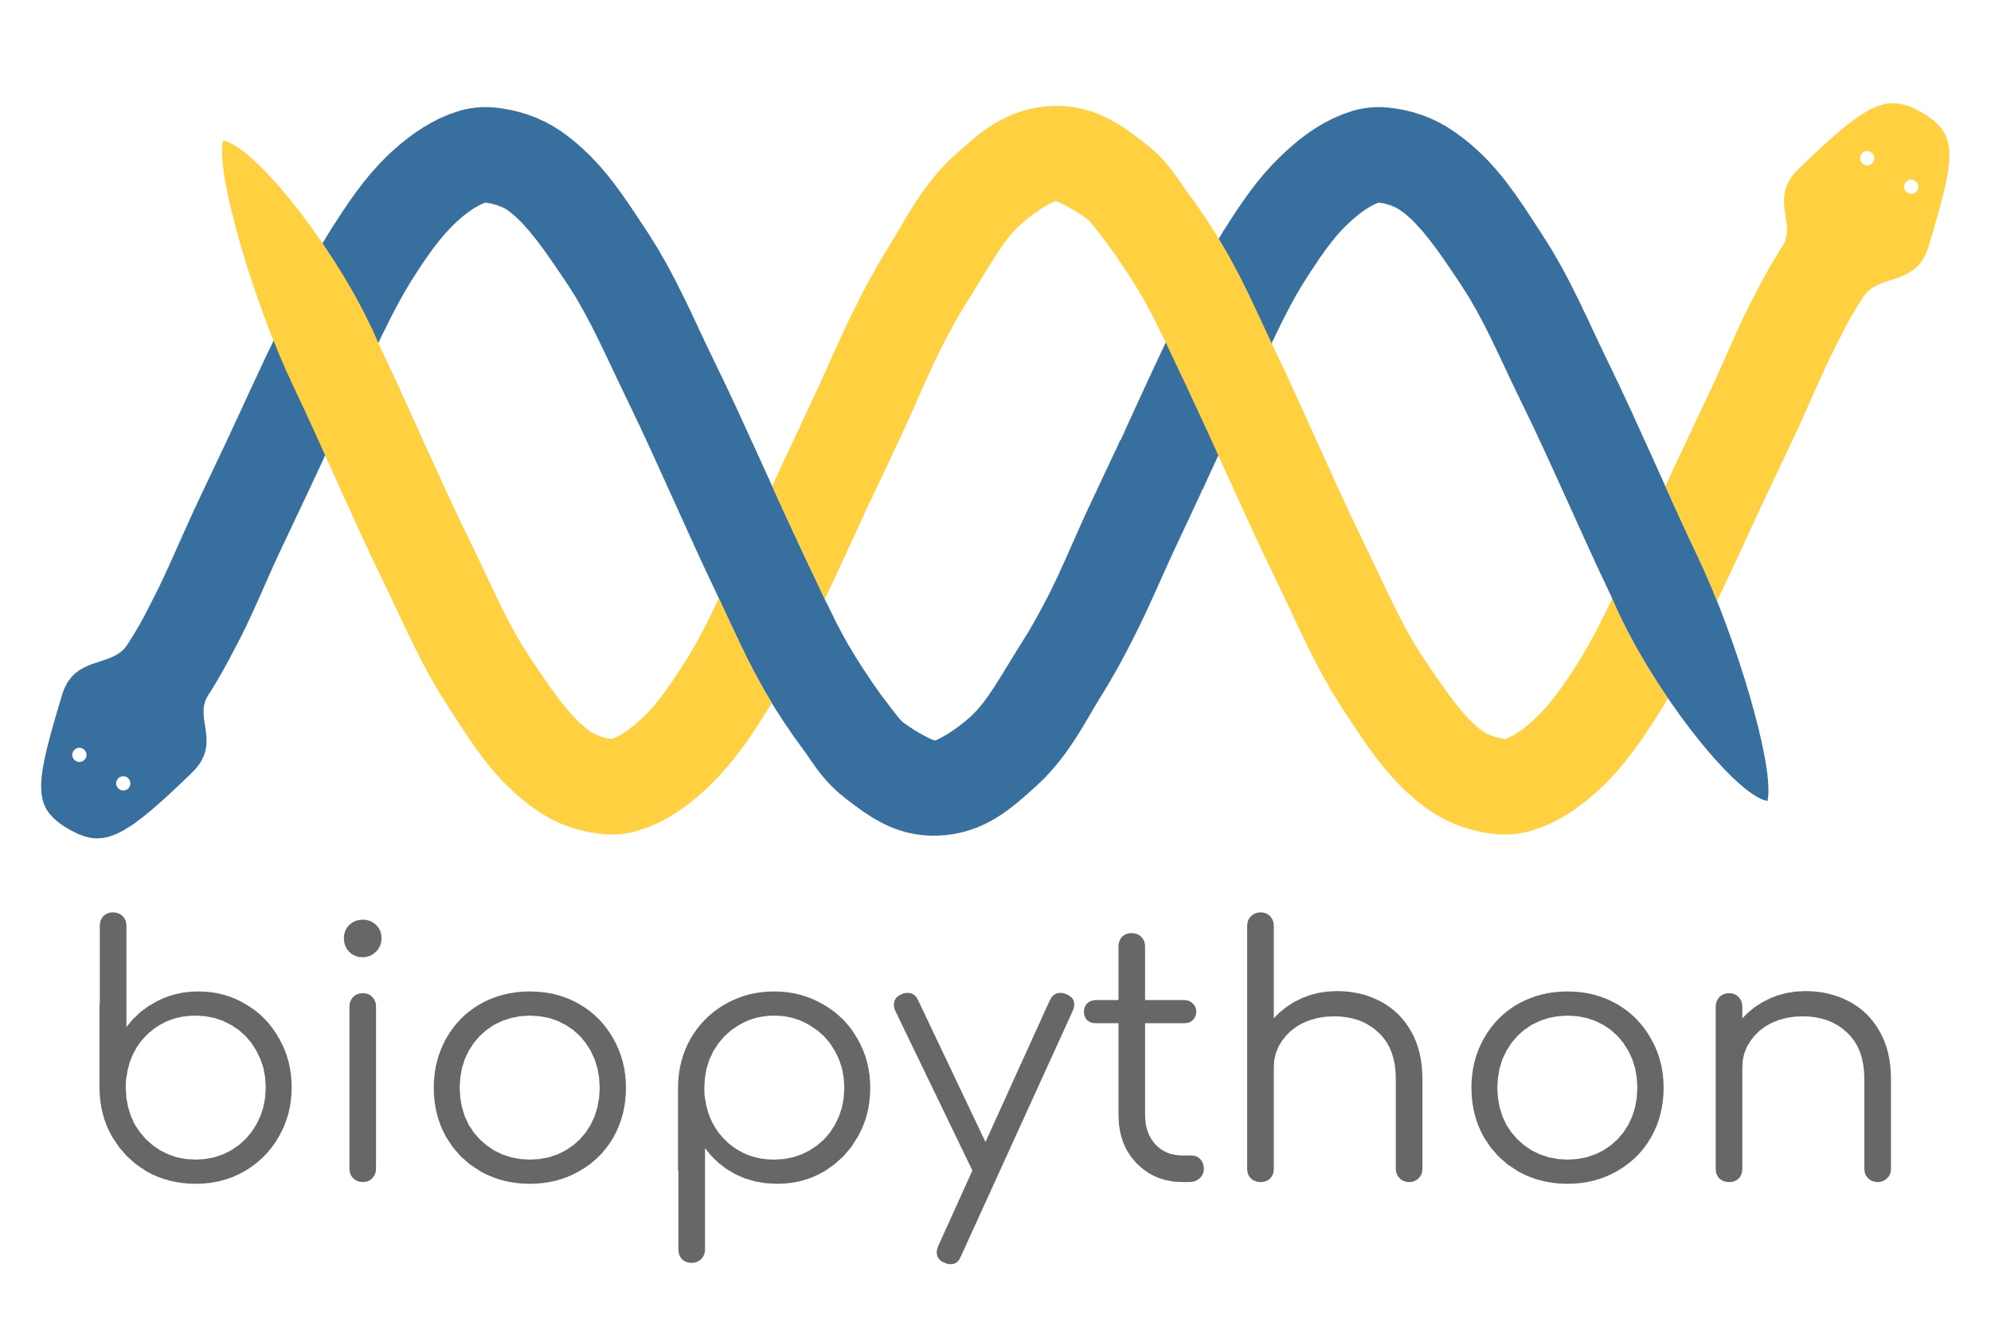

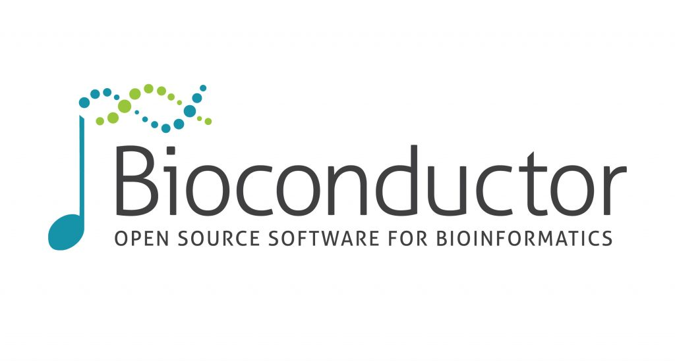
An open source field: BIOINFORMATICS
Basically genetics and computer science, this is one of the larger fields outside of traditional data science to adopt the open source model– many use a both Python and R as well as C/C++, Perl, Unix
R: Bioconductor base + supplemental packages, huge online community
Python: Biopython
Often times more than one language is needed to develop your analysis pipeline, however both languages have packages that can work with each other (for example Python can be used in R, etc).
Both languages have an extremely active community that embrace open source
Each language has its strengths and weaknesses however there is nothing holding you back from simply using both

Slide 15
projects that already benefit from open sourcing
Scientific software is not all analysis and filtering

Slide 16
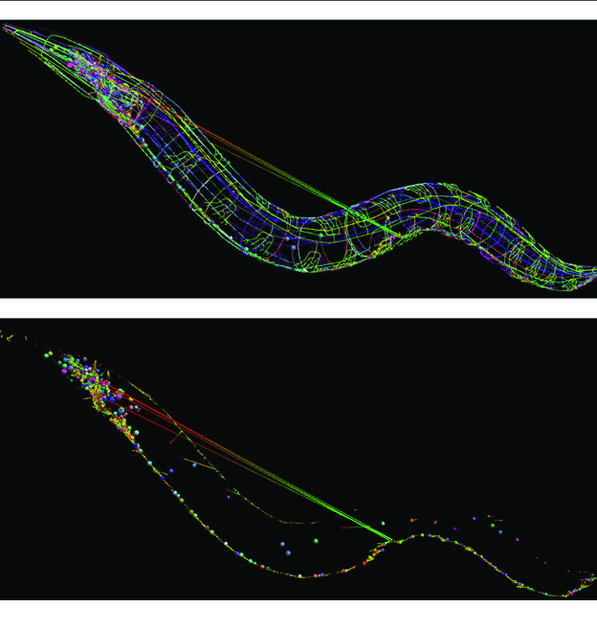

Image SLide
OPENWORM (2014)
A project that started off as a Kickstarter fundraiser, is an independent science project that sought to perfectly emulate the C. Elegans worm on personal computers.
-The first complete simulation of an entire organism
-Raised $121,076 with 799 backers
-Is a significant building block to eventually emulating a rodent model, which is much more complex. This amount of work would no doubt require the expertise and hard work of hundreds of people– ideal for open sourcing.
From OpenWorm we have the following projects:
-OpenWorm Browser, DevoWorm, NeuroML Connectome, Geppetto, Sibernetic (Worm body simulator), ChannelWorm2, c302, WormSim, & more
Image: Vella, Mike et al.(2014). libNeuroML and PyLEMS: Using Python to combine procedural and declarative modeling approaches in computational neuroscience. Frontiers in neuroinformatics. 8. 38. 10.3389/fninf.2014.00038.
https://github.com/openworm

Slide 17
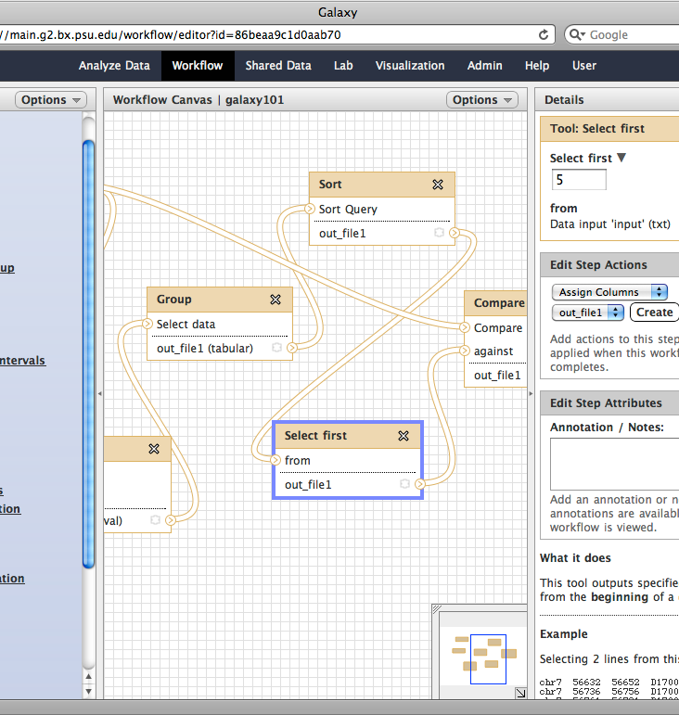

Image SLide
GALAXY PROJECT
“Galaxy is a scientific workflow, data integration, and data and analysis persistence and publishing platform that aims to make computational biology accessible to research scientists that do not have computer programming or systems administration experience.”
GUI friendly but still open source workflow intended to be used by researchers who are using bioinformatics in their work but are not trained as bioinformaticians
By actively developing and fostering a great community, the users don’t have to worry about the under-the-hood of the application
Specialized tools are developed for most cell types and different analyses for various data types
Makes a cutting edge field rather accessible
https://usegalaxy.org

Slide 18
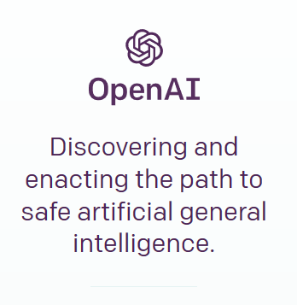
Image SLide
OPEN A.I. PROJECT
“OpenAI is a non-profit AI research company, discovering and enacting the path to safe artificial general intelligence.”
-Many researchers are interested in incorporating AI or Machine Learning into their work, but lack the knowledge needed to make their own algorithms
-OpenAI already conducts research and publishes regularly, and provides a means towards the safe development of AGI
-Currently staff 60 researchers and engineers full-time
-Develop open source platforms and tools for researchers to use and implement algorithms into their work
https://github.com/openai

Slide 19
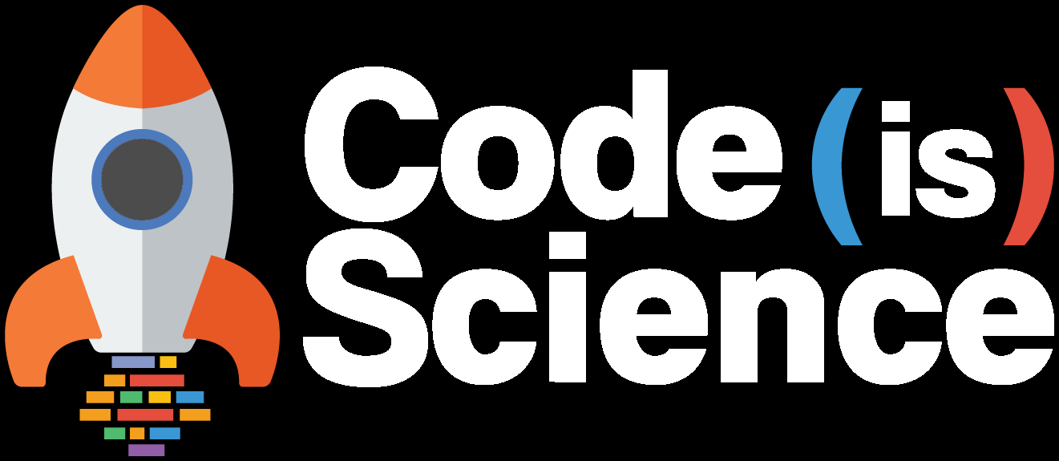

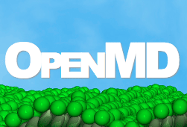

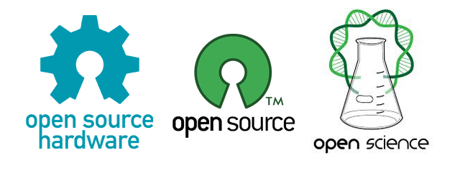







Image SLide
OTHERS

Slide 20
In summary: why should we open source scientific software?
Reproducibility
Without the original code, nobody will ever be able to truly reproduce the results
Transparency
If the code used for analysing the data was poorly written, we need to know
Contributability
If the code is bad, let others help you improve it!
Reduced Costs
Let’s cut down licensing costs on proprietary software
Reduced Redundancy
Why waste time writing code when it already exists and is actively maintained?
Better Tools to Streamline Innovation
This way we are able to take full advantage of new technology as it rolls out and are not reliant on a core development team to implement them into their own software

Slide 21
Honest thoughts
What seems to be the main issue here is not that there aren’t enough benefits for open sourcing, but instead that our holdbacks are too great
Our institutions needs to incentivize and reward contributing to open source, actively maintaining projects, and bug fixing
Tenure-track prospects must go beyond just impact scores and citation counts
Community engagement needs to be recognized as contributing to science, and in a big way
Researchers need to connect with each other online and troubleshoot openly
There needs to be a way to directly streamline programmers and computer scientists into projects from fields that don’t have strong coding backgrounds
We need to end the hold current propriety software has on universities

Slide 22

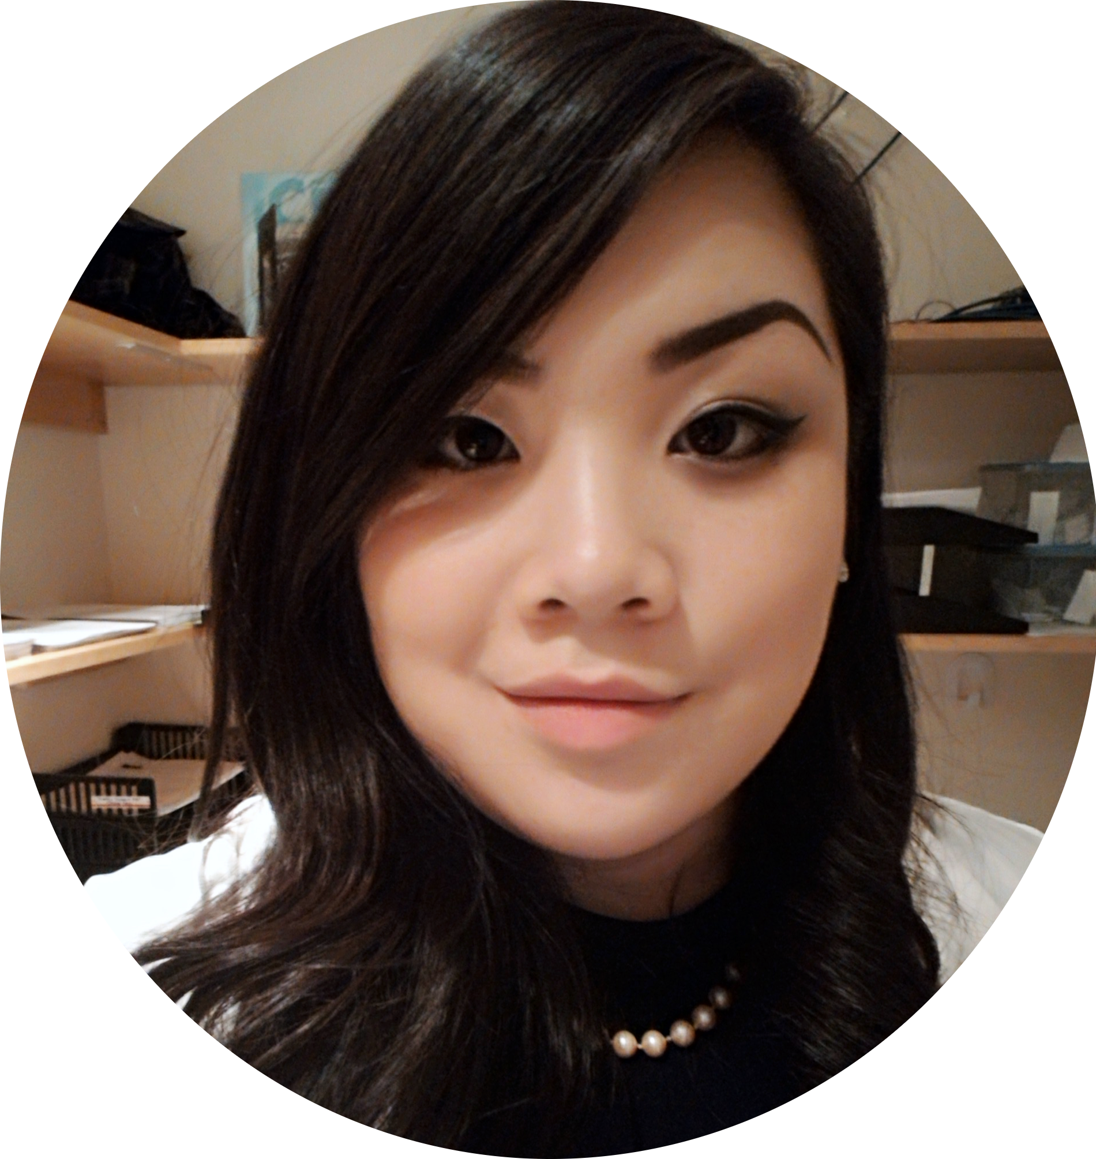



About ME
A BIG THANK YOU TO:
Research Assistant at the Circadian Rhythms and Sleep Neuroscience Lab & Behavioural Neuroendocrinology Lab, SFU Psychology Department.
SFU Scientific Programming Group
RLadies & PyLadies Member
FIND ME ON SOCIAL MEDIA:
Twitter: @lisancao
lisanatashacao@gmail.com
Github: github.com/lisancao

